Slide 1
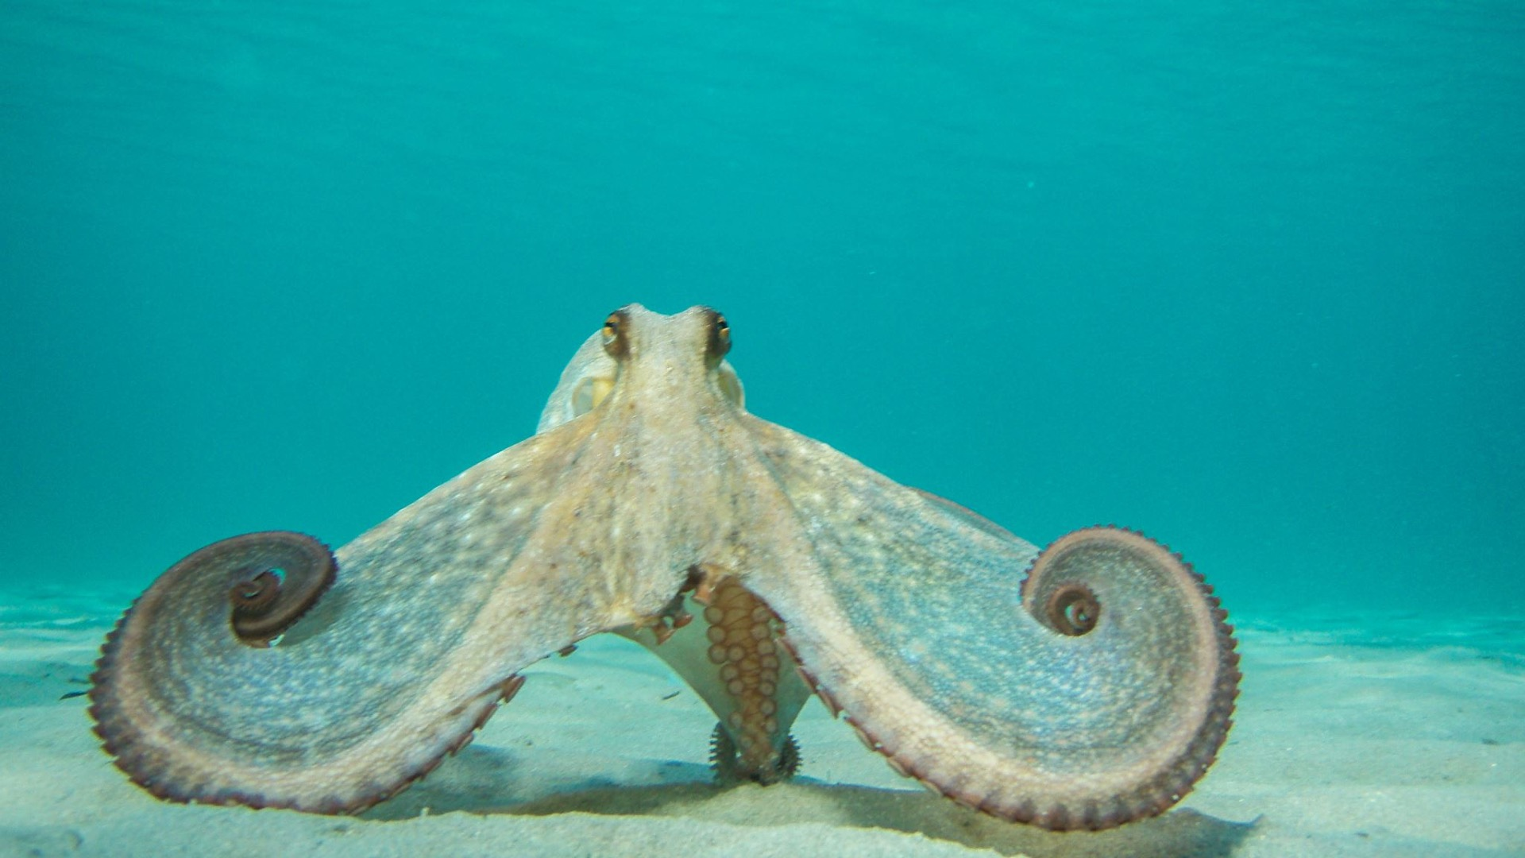
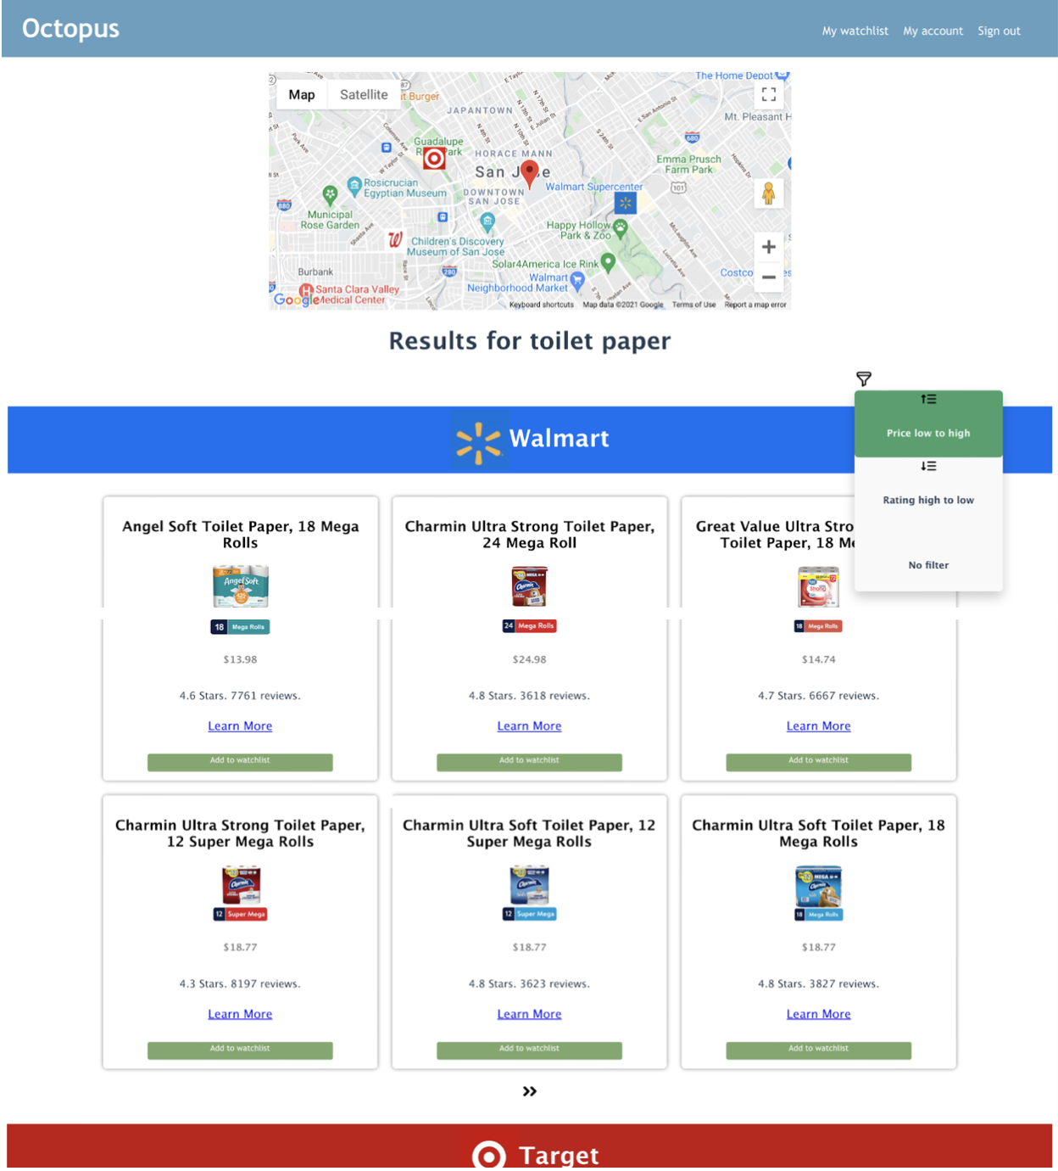
Commodity information integrated recommendation system based on crawler technology and geographic location by Brian Hsu, Xiaohan Jiang, Lei Zhang, Yakun Feng
Octopus
Notes:
Hello, we are group 11. The topic of our master project is Commodity information integrated recommendation system based on crawler technology and geographic location, and the name of our application is Octopus.

Slide 2
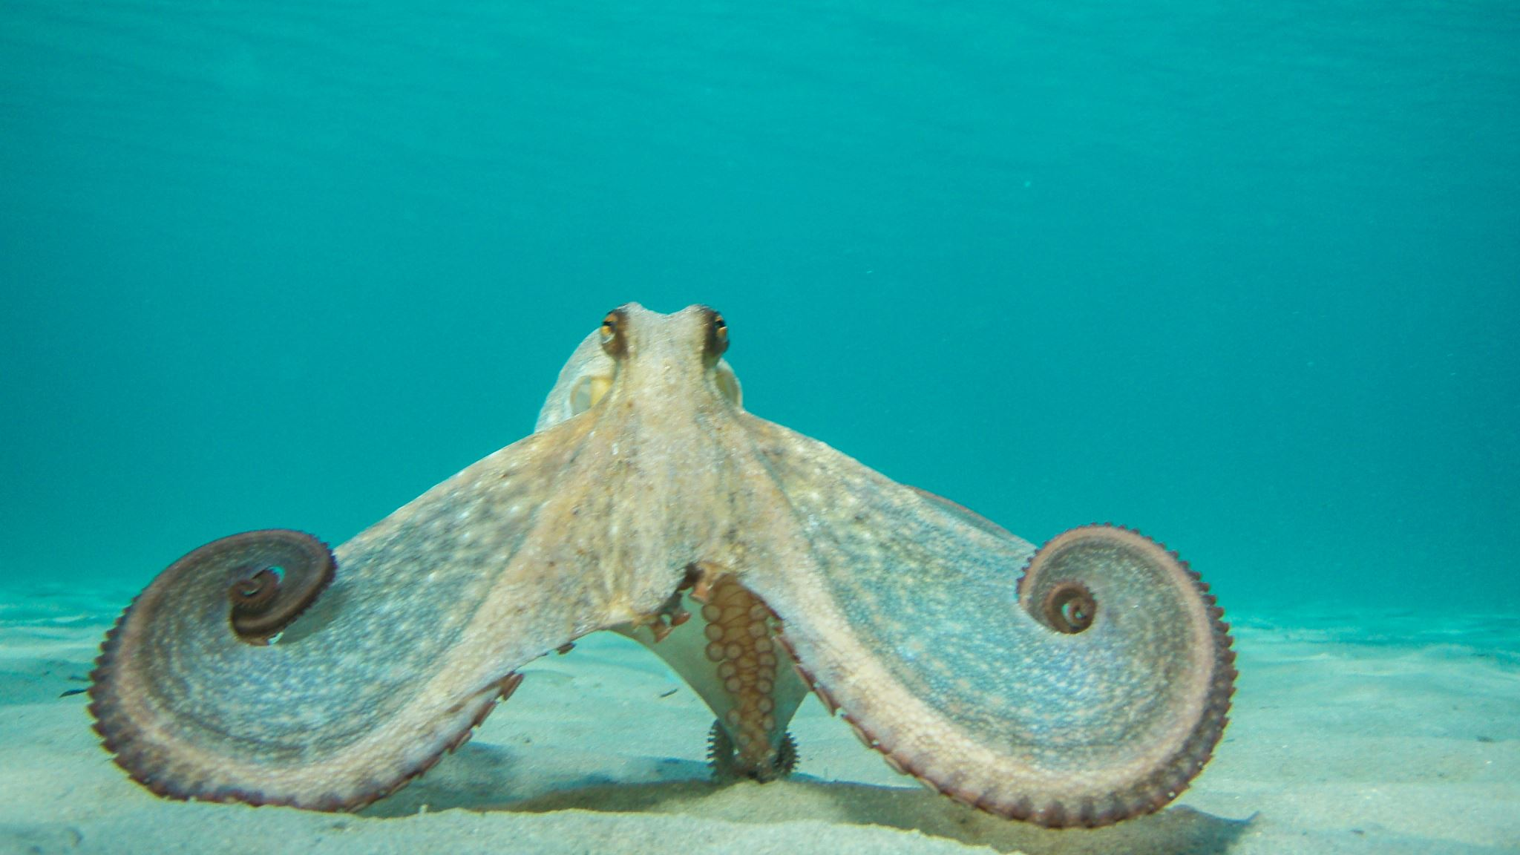
Why Octopus?
Notes:
So, why Octopus? What problem can it solve?

Slide 3
Why Octopus?
According to Forbes’s report, E-commerce accounts for around 35% of Walmart’s total revenue in 2021, which skyrocketed due to the pandemic.
→ Offline sales account for 65%, which is still the mainstream shopping style.
(nearly 2 times the amount of the online sales)
Advantages of in-store shopping
- getting products faster
- better guarantee of the product’s quality
Notes:
According to Forbes’s report. The revenue of E-commerce of Walmart skyrocketed to 35% due to the pandemic. However, no matter how much it has increased, in-store shopping is still the main-stream shopping style. Customers prefer in-store shopping not only because they can get the products faster but also have better guarantee of the product’s quality.

Slide 4
Why Octopus?
Due to the pandemic, products such as toilet paper, face mask, and hand sanitizer, are often out of stock.
→ Customers often spend time visiting several stores but cannot get what they need, because they don’t have the inventory information of the stores in advance.
→ Octopus is here to solve this problem!
Notes:
However, due to the pandemic, products such as toilet paper, face mask, and hand sanitizer, are often out of stock, which causes the customers to spend time visiting several stores but cannot get what they need, because they don’t have the inventory information of the stores in advance, and that’s why we need Octopus! Our app grabs information for you near you just like an octopus stretching its hands in all directions!

Slide 5
What is Octopus?
Notes:
So, what is Octopus?

Slide 6
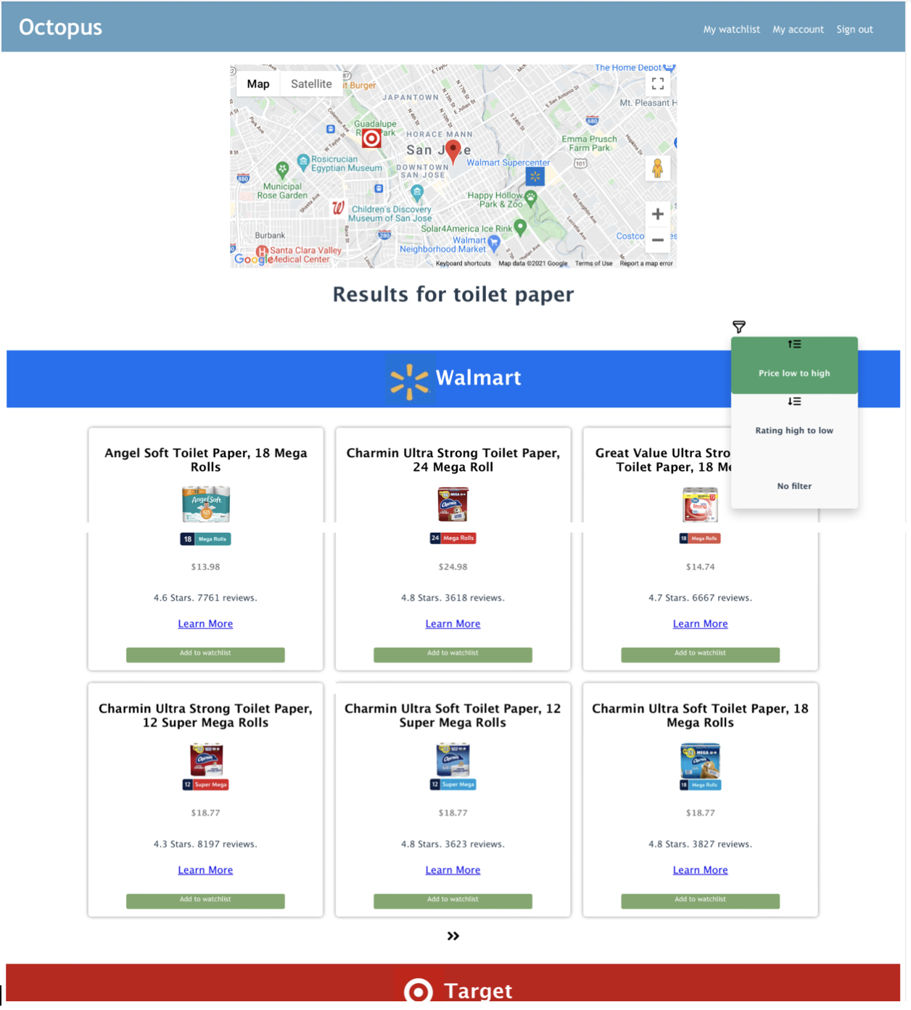
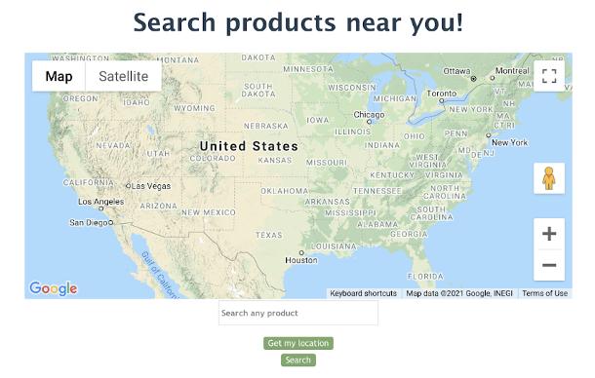
What is Octopus?
Octopus is a web application that utilizes crawler technology to scrape the inventory information in the websites of the stores, i.e., Walmart, Target, and Walgreens, that are near the users, and then integrate the information into one single platform for the users.
Functionalities of Octopus:
- Search product by location and name.
- Stores’ locations shown in map and products’
information shown in listing cards.
- Sort products by price or rating.
- Personal watchlist to keep track of the products.
Search Page
Search Results Page
Notes:
Octopus is a web application that utilizes crawler technology to scrape the inventory information of the stores, that is., Walmart, Target, and Walgreens, near the users, and then integrate the information into one single platform.
By choosing a location on the map and entering a product name in the search page, users can get the search results including the locations of the stores and the inventory information of the stores in the search results page. Users can also sort the products by price or ratings and add products to their watchlists if something is temporarily out of stock.

Slide 7
The Technology behind Octopus
Notes:
Now let’s talk about the technology behind Octopus.

Slide 8
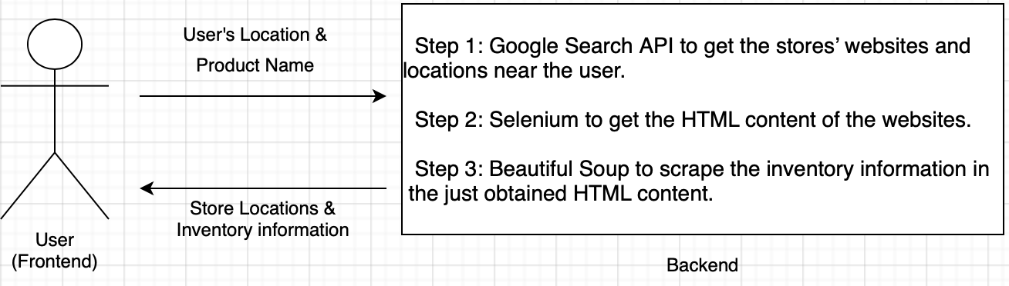
Workflow of Octopus
Note: Step 2 + Step 3 = Web Scraping (Web Crawling)
Notes:
This image shows the workflow of the main function of Octopus. After the backend gets the user’s location and the product he or she wants to search, the first step is to get the locations and the websites of the stores near the user by using Google search API. The second step is to visit the websites of the stores just obtained from the first step to get the html content of the web pages using a library called selenium, and the third step is to scrape the product information in these html content using a python library called BeautifulSoup.
One thing I want to mention here is that, step 2 together with step 3 is called web scraping or web crawling, this is a technology that enables us to make a request to a webpage and get the information in it.

Slide 9
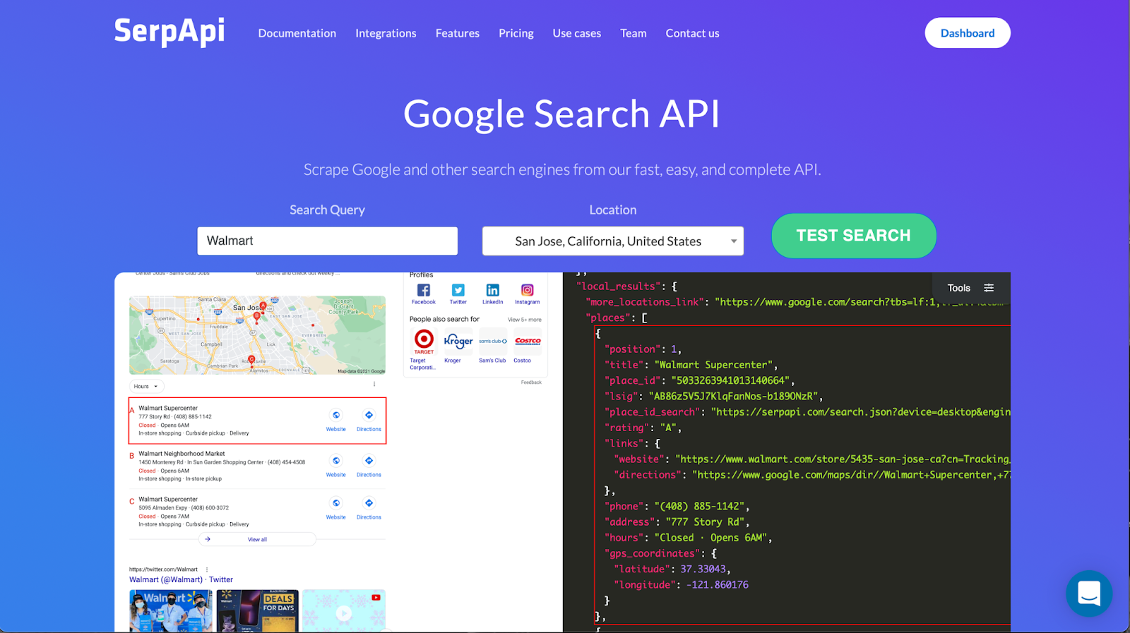
Google Search API (SerpApi) – Step 1
Google Search API is used to get the websites and locations of the stores near the users.
(A normal web scraping method cannot get certain information in the Google Maps search results)
Notes:
Let’s talk about the first step. To get the websites and locations of the stores near the users, we have to use Google Search API. You might wonder why don’t we use the web scraping method I just mentioned. It is because certain information such as website of the store is not shown in the HTML content of Google Maps search results. This Google search API is offered by a company called SerpApi, which will give you basically every information you can see in the Google Maps search results.

Slide 10
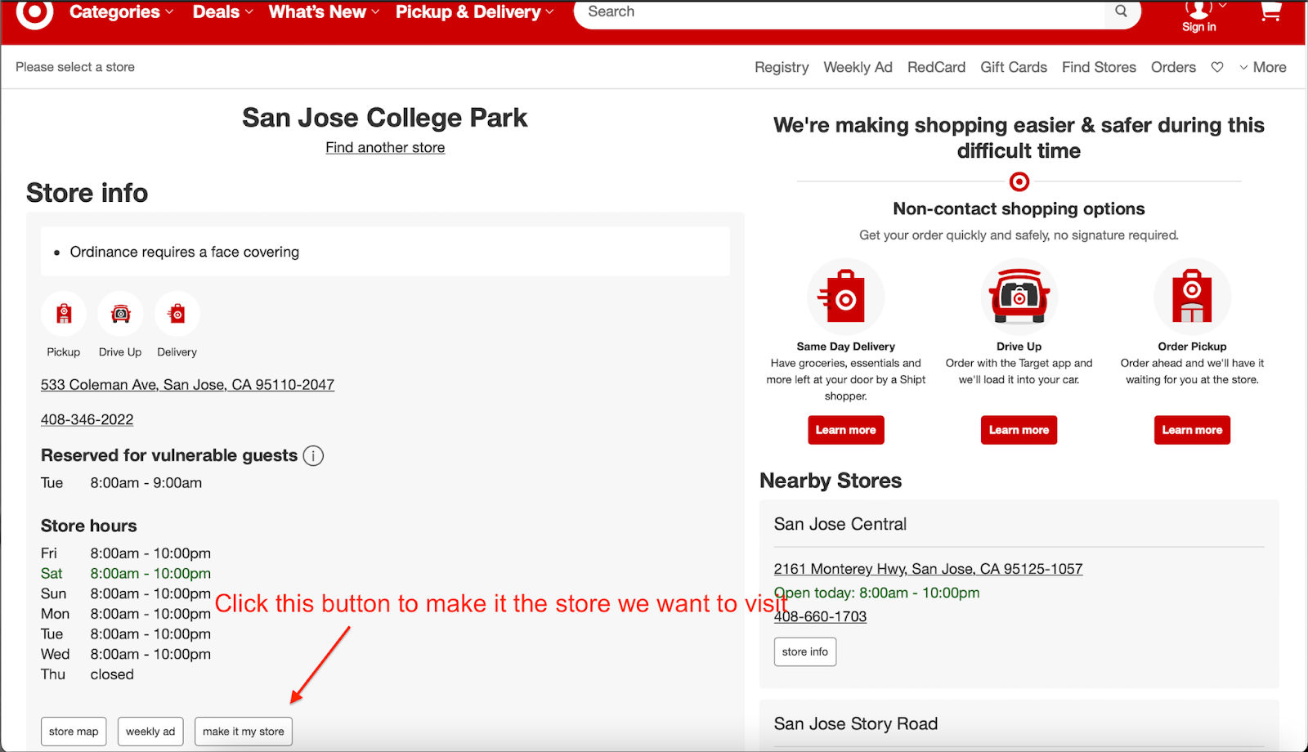
Selenium – Step 2
To visit the store and get the inventory information, user interactions such as clicking a button is necessary.
→ A library called Selenium can automate the user interactions with the web pages in the backend.
Notes:
Once we get the websites of the nearby stores, Selenium’s web driver will visit those websites to get the html content. However, this cannot be achieved by simply visiting a URL. For example, the image here is the website of the Target near San Jose State University. We have to click the “make it my store” button to make this store the store we want to visit. Selenium can do this task for us because it can imitate user’s behavior and interact with the websites automatically in the backend.

Slide 11
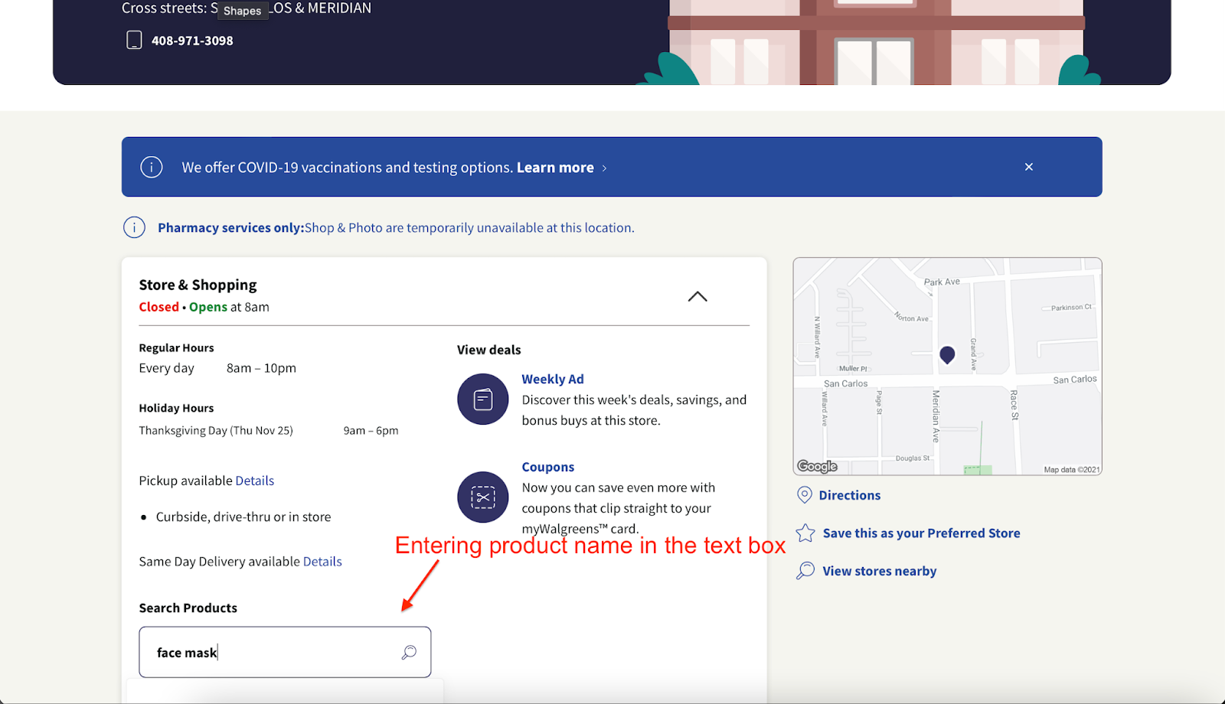
Selenium – Step 2 (Cont’d)
To search for a specific product in a specific store, this cannot be done by simply visiting a URL. Entering text into a search bar is necessary.
→ Use Selenium to automate this user interaction in the backend.
Notes:
Another example of using Selenium is entering text into a text box. The image here is the website of the Walgreens near San Jose State University. To search for a specific product in this Walgreens, this cannot be achieved by simply visiting a URL. We have to first visit the website of Walgreens and enter the product we want to search in the search bar, and this can also be automated by using Selenium in the backend.

Slide 12
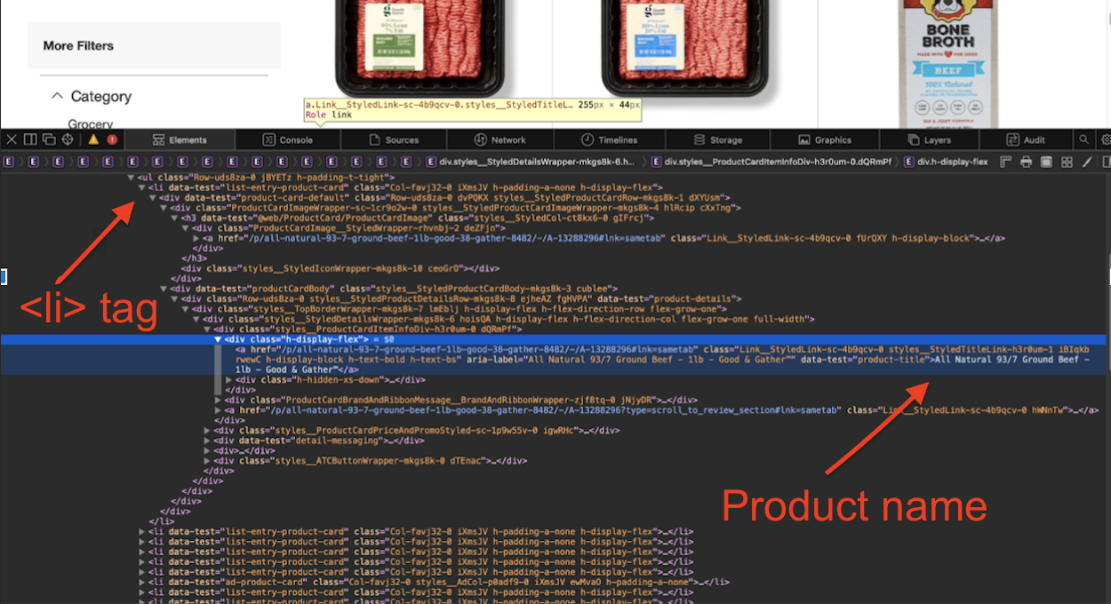
Beautiful Soup – Step 3
Beautiful Soup is a python library that can scrape anything in the html content visible to us.
Ex: To get the first product name in the web page, tell Beautiful Soup to get the content under the
<div class = “h-display-flex”> tag of the first <li> tag.
Notes:
After getting the html content of the web pages, in step 3 we use a python library called Beautiful Soup to scrape the information we want in the html content. This image is the html content of the product page for beef in the Target near San Jose State University. Under each <li> tag contains the information of a single product. For example, If we want to get the first product name pointed by this red arrow, we have to tell Beautiful Soup to look for the content under this blue highlighted tag of the first <li> tag. This might sound a bit complicated, but basically Beautiful Soup can find information by the HTML tags.

Slide 13
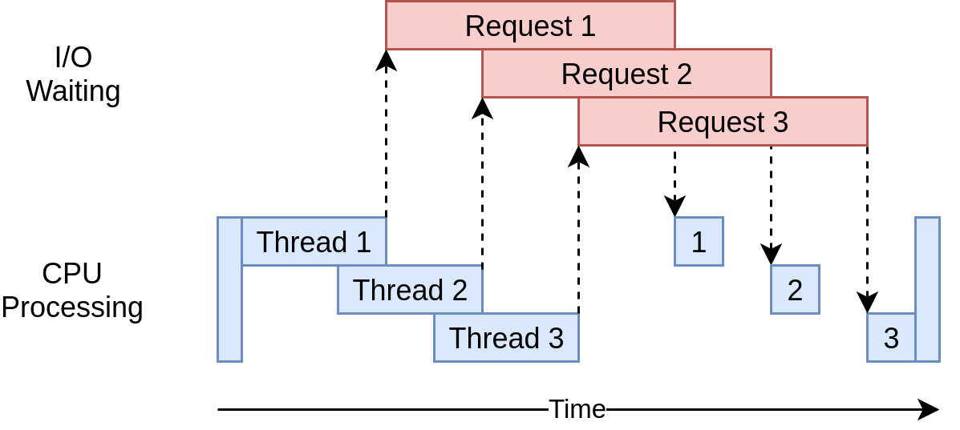
Multithreading
Multithreading is applied to speed up the whole process.
Each thread
is responsible for one website.
→ Speed is two times faster!
Notes:
Last but not least, Multithreading is applied in our app to speed up the whole process I just talked about. One thread responsible for one website, and the speed is almost two times faster compared to the speed without using multithreading. The reason that it speed up so much is that there is a lot of time spent in I/O waiting when visiting websites, Multithreading can make other threads work while a thread is waiting for the I/O process to be done.

Slide 14
Thank you!
Q/A
Notes:
And that’s all for our presentation. Thank you for your time! Any questions?

